Slide 1

STORY BOARDING
SELECTED PRODUCT :- HANUMAN FITNESS APP
SPSU " TEAM ANONYMOUS" TASK#06

Slide 2
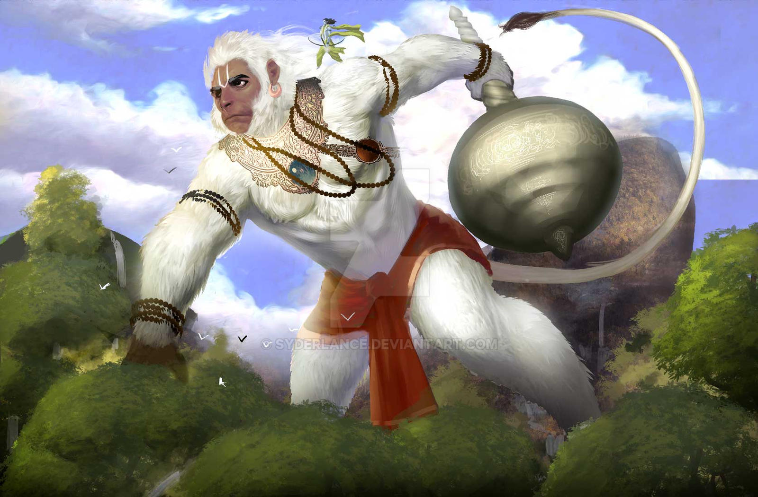
ABOUT FITNESS OF HANUMAN
Hanuman, the monkey god from the Hindu epic ramayana, symbolizes strength, devotion and energy. His remarkable feats, such as flying across the ocean to find sita and lifting the entire mountain to bring medicinal herbs, have inspired millions. Hanuman's physical and mental strength can serve as a metaphorical guide for fitness enthusiasts.
ThePhoto by PhotoAuthor is licensed under CCYYSA.
ThePhoto by PhotoAuthor is licensed under CCYYSA.

Slide 3
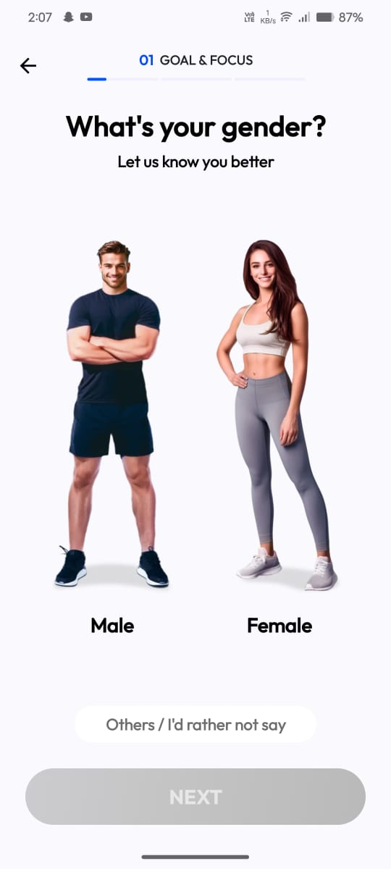
Title :- " HANUMAN FITNESS APP"
Scene 1:-
Home screen
Satwik is an teenage boy who is bigger in personality when compared to his friends. Satwik wants to do workout at home itself as he wouldn't pay gym fee.
He downloaded the Hanuman fitness app , it is the app which appears same like remaining fitness app.
The app first asks us about our personal information, the first question about the gender.

Slide 4
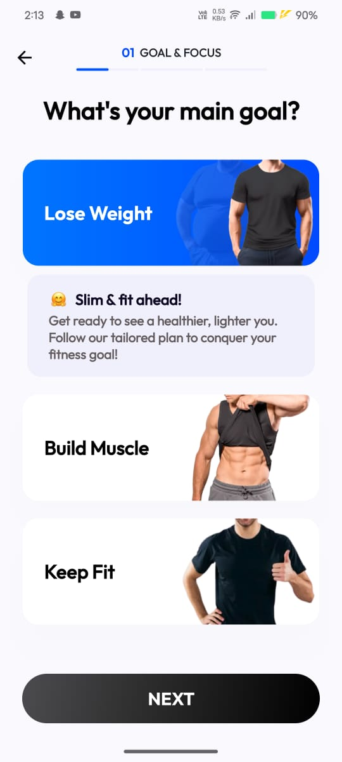
Scene 2:-
The app asks few questions to prepare a schedule for you to reach your goals like:-
What's your main goal ?
Which area you want to focus more ?
What motivates you the most to do workouts?
What is your birth year ?
What is your height ?
What is your weight ?

Slide 5
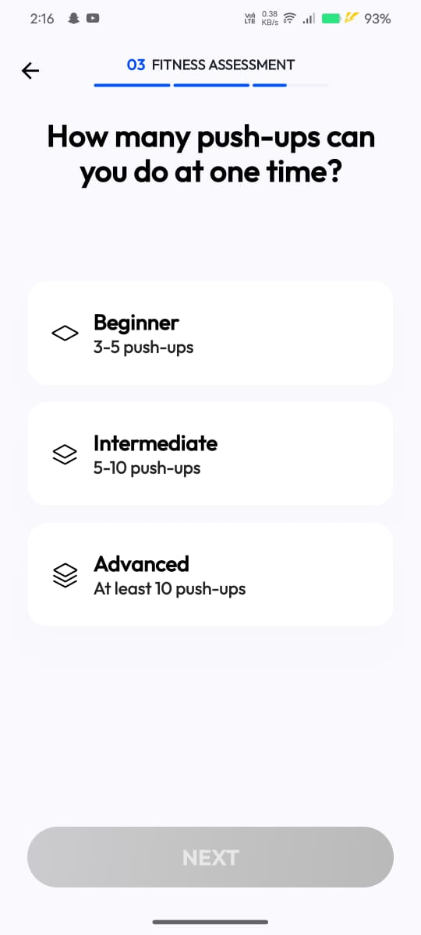
Scene 3:-
Which exercise type do you prefer ?
Do you have any injury for any part ?
How many pushups can you do at one time ?

Slide 6

Premium Plan
Personalized Workout Plans :- One of the main attractions of premium plan is access to customized workout routines tailored to your specific fitness goals, body type and fitness level.
Ad- Free Experience :- One of the often-overlooked perks of premium fitness plans is the ad-free experience.
Offline Access :- For users who travel frequently or have limited internet access, premium plans often come with the ability to download workouts for offline use.
Access to Expert Trainers :- Premium plans often connect users with expert trainers and coaches who provide guidance on exercise, nutrition and recovery.

Slide 7
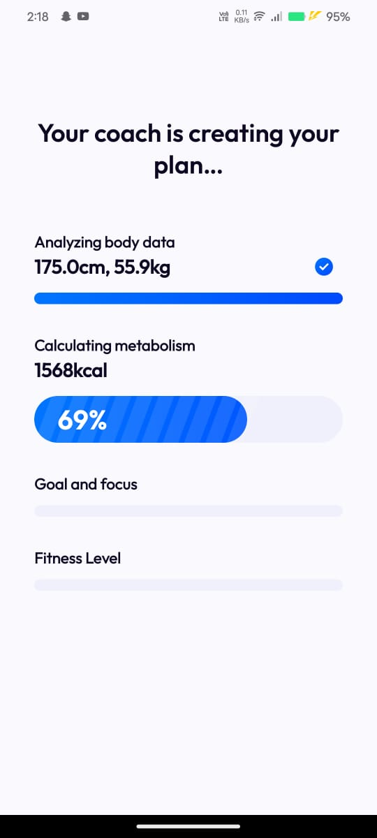
AI Coach Creates A Plan
Using advanced motion-sensing technology or your phone's camera, the AI coach can detech improper form or posture during execises and offer suggestions.
The AI can assess the number of reps, speed and overall efficiency of your movements, helping you maximize your workout.
The AI coach sends daily reminders to encourage you to sick to your fitness routine, helping you maintain consistency.
By setting personalized fitness milestones, the AI keeps you motivated and provides rewards when you reach your targets.

Slide 8
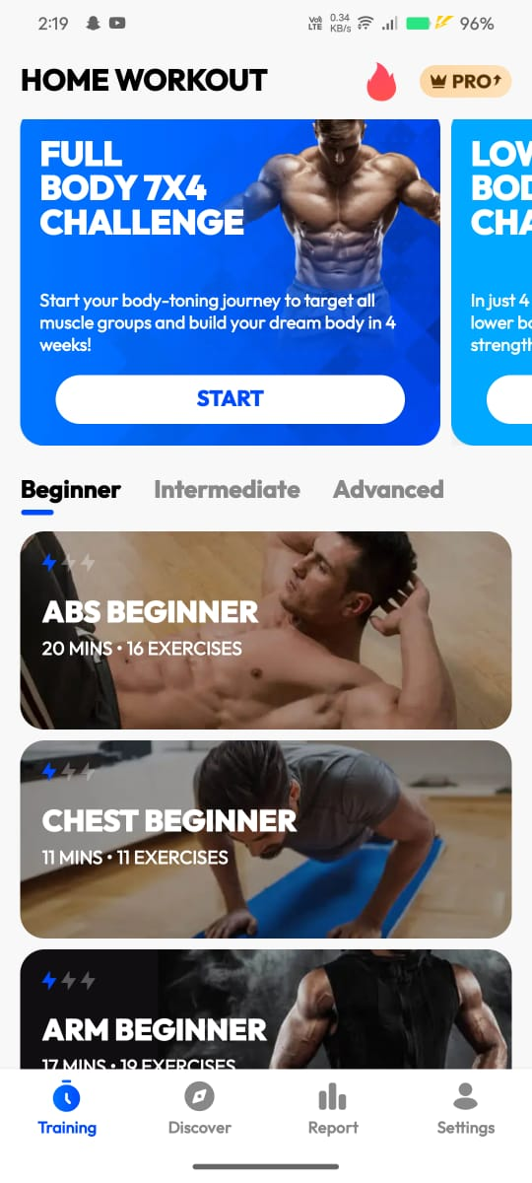
Daily Schedule
We will have different schedule daily for whole week.
The schedule will be divided like :-
- ABS
-CHEST
-ARM
-LEG
-SHOULDER&BACK
We need to be consistent.

Slide 9
Plot :-
The plot of the app revolves around personalization, progression and user engagement. By incorporating elements like AI coaching, fitness challenges, goal-setting and social interaction, the app creates a dynamic and immersive experience for users. The central narrative of continuous growth, coupled with rewards and personalized guidance, ensure that users stay motivated and committed to achieving their long-term fitness goals.
Characters: 1. Satwik (user) 2. Hanuman fitness(App)

Slide 10
About the Hanuman Fitness App
THANK YOU
TEAM ANONYMOUS (SECTION E)
Y.DURGA PRASAD
G.ABHILASH
V. PRANAY KUMAR
P.SAI
P.G.VISHWA TEJA

